Slide 1
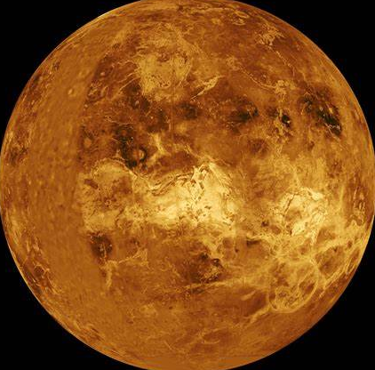
Venus
Anirudh

Slide 2
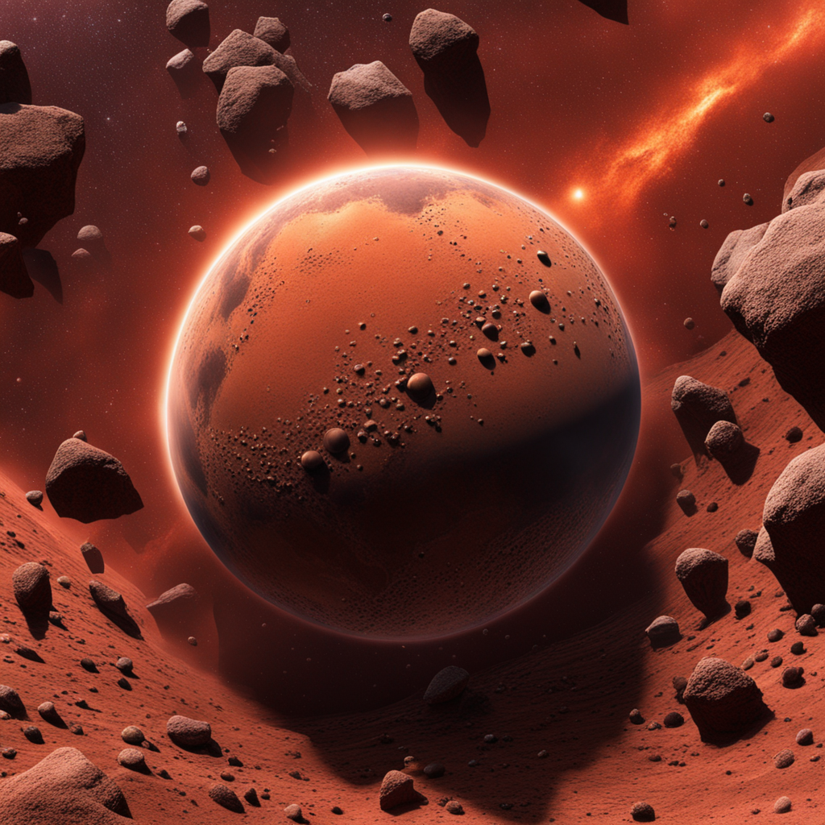
Formation of Venus
Accretion and Gravity
Venus formed about 4.5 billion years ago
Venus formed through a process called accretion.
Accretion is the gradual accumulation of dust, gas, and other materials in space.
Gravity played a crucial role in the formation of Venus.

Slide 3

Brief info on Venus
Similar to Earth in size and shape
Spinning
Atmosphere
A day on Venus lasts for 243 Earth days
An year on Venus lasts for 225 Earth days

Slide 4
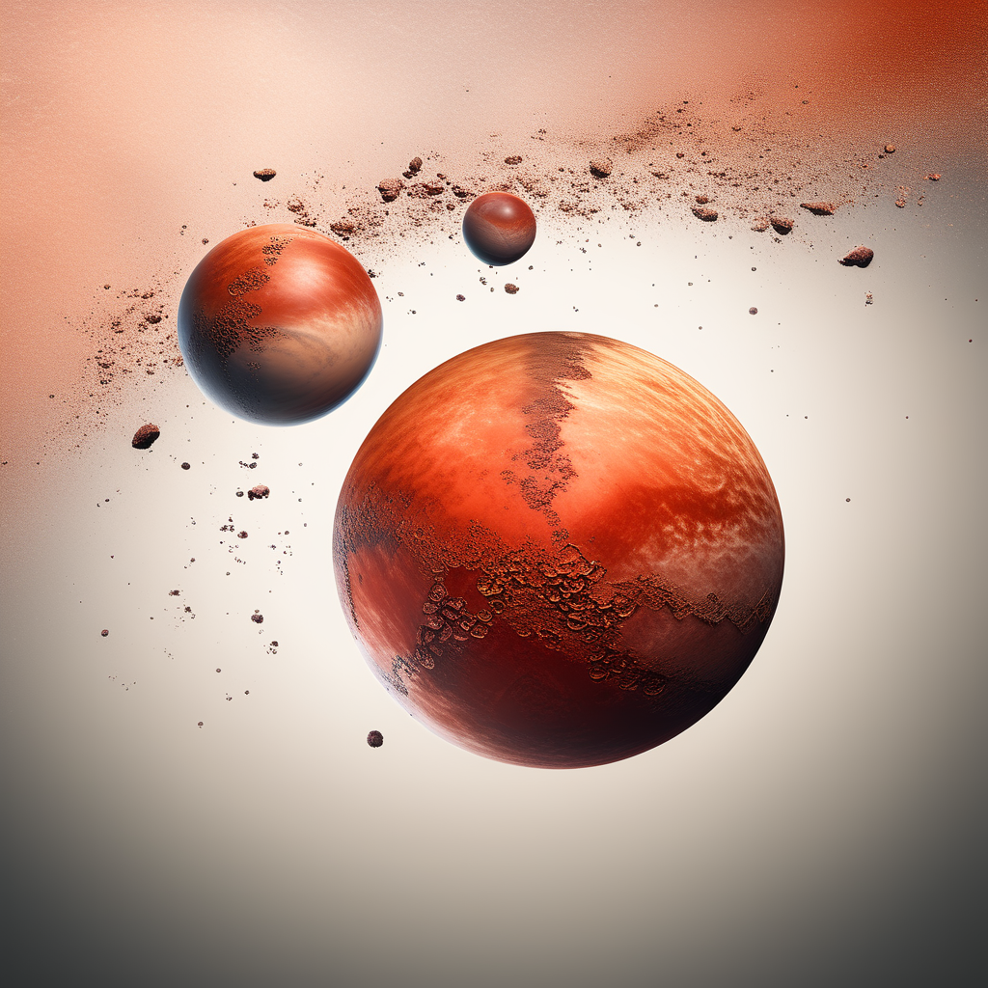
Composition
Rocky Mantle
The rocky mantle of Venus is primarily composed of silicon and iron.
Iron Core
The iron core of Venus is responsible for generating its magnetic field.

Slide 5
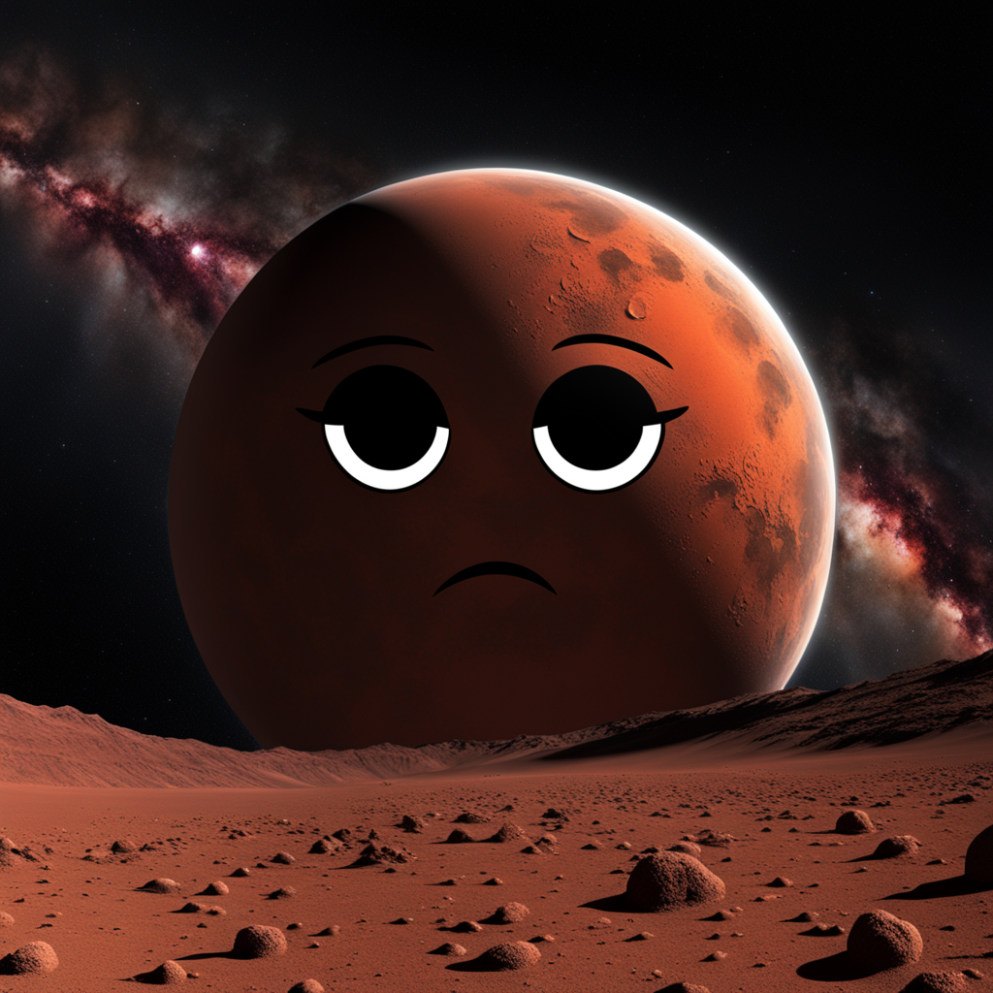
Can you live on Venus?
No
Why?
High Temperature
High Pressure

Slide 6
464°C

Slide 7
90,00,000-92,00,000 Pa

